Slide 1
Gesture recognition using wearable vision devices
Candidato: Lorenzo Baraldi
Relatore: Prof. Rita Cucchiara Correlatore: Ing. Giuseppe Serra

Slide 2
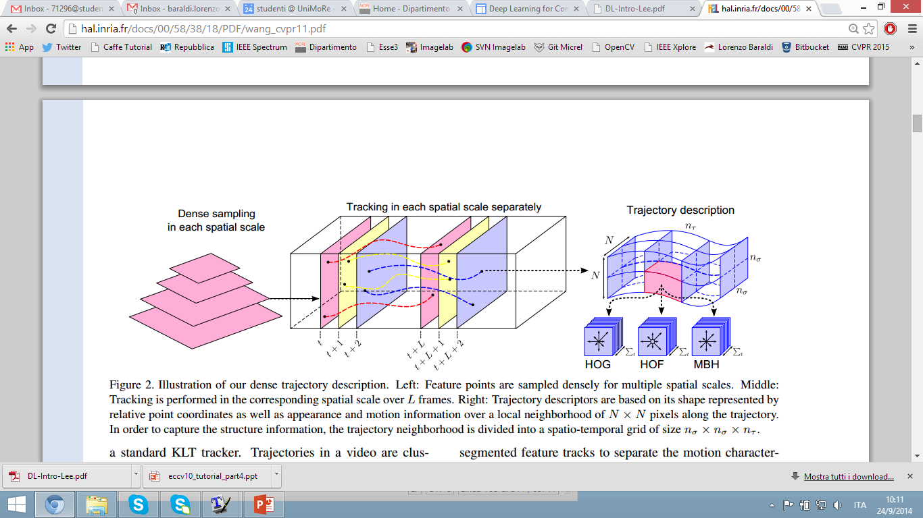
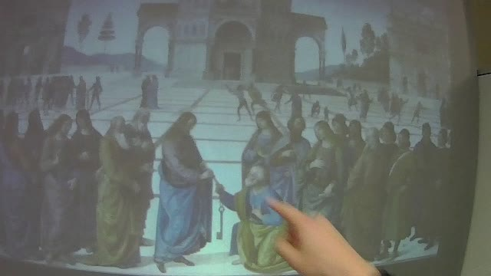
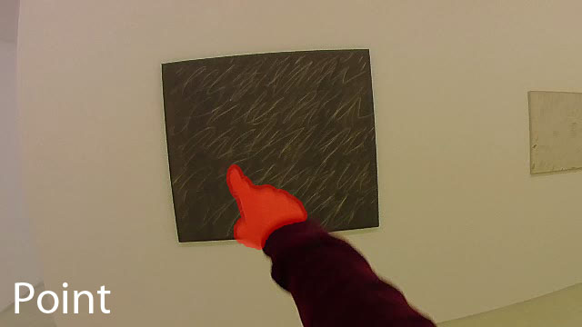
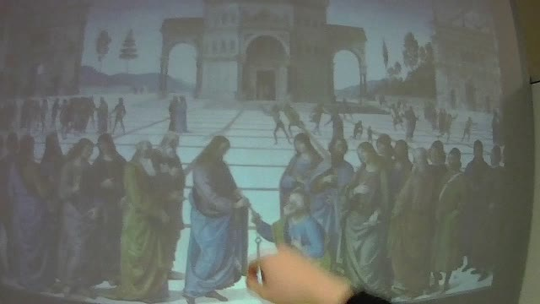
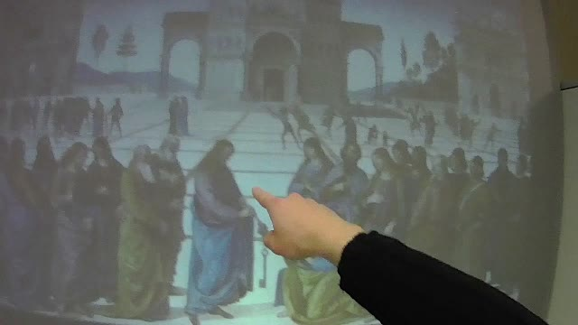
THE TRADITIONAL RECOGNITION APPROACH
Input data
Feature representation
Learning algorithm
BoW of Spatio-temporal features extracted around trajectories
Linear SVM or Struct SVM
Frame sequence

Slide 3
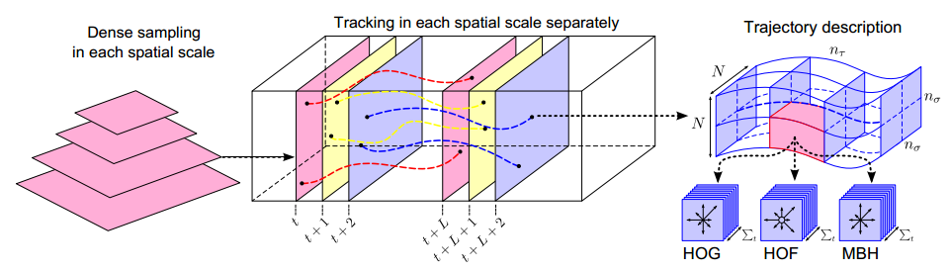
METHOD OVERVIEW
We propose to describe each gesture as a collection of dense trajectories [1] extracted around hand regions. To detect hand regions, we propose a hand segmentation algorithm.
Feature points are sampled inside and around the user’s hands and tracked during the gesture; then several descriptors are computed inside a spatio-temporal volume aligned with each trajectory.
These descriptors are coded using the Bag of Words approach and then classified using a linear SVM classifier.
[1] H. Wang, A. Klaser, C. Schmid, and C.-L. Liu. Action Recognition by Dense Trajectories. In Proc. of CVPR, 2011.
Notes:
Here you can see an overview of our method. We propose to describe gesture as a collection of dense trajectories extracted around hand regions.
When the user’s hands appear, feature points are sampled inside and around the hands tracked during the gesture. Then a bunch of features are computed inside a spatio-temporal volume of each “aligned” trajectory. Later BoW coding and SVM are used to recognize the gestures. In the next slides first I will focus on the gesture recognition algorithm supposing that we have for each frame a segmentation mask of the hand. And later I will describe our hand detection algorithm.

Slide 4


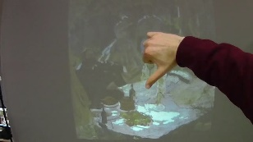
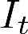
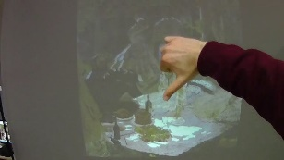
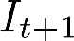
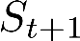
CAMERA MOTION REMOVAL
To correctly estimate hand motion, it is first necessary to remove camera motion, which is semantically noise.
In first-person camera views hands movement is usually not consistent with camera motion, resulting in wrong matches between the two frames.
For this reason we introduce a segmentation mask that disregards feature matches belonging to hands
Original frame sequence
Extract dense keypoints
-
Output frame sequence
without camera motion
Estimate Homography
Extract dense keypoints
-
Apply to
Notes:
To correctly estimate the hand motion and the feature point trajectories is necessary to remove camera motion. ….
For two given frames we densely extract SURF features and we discard features belonging to hands. Later the homography transformation between these two consecutive frames is estimated running the RANSAC algorithm. When you have the homography we can warp or rectifier the frames removing camera motion.

Slide 5
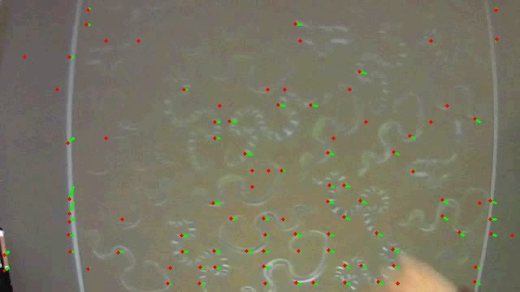
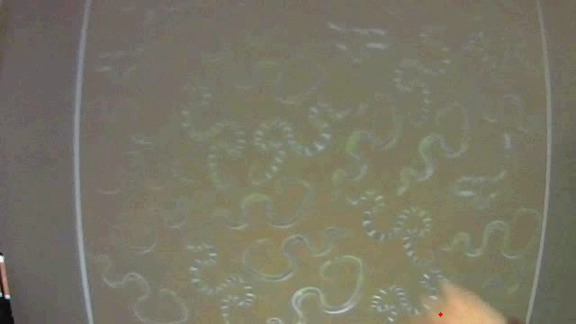
TRAJECTORY DESCRIPTION
Having removed camera motion between two adjacent frames, trajectories can be extracted.
Feature points are densely sampled at several spatial scales and tracked. Trajectories are restricted to lie inside and around the user’s hands.
Without hand segmentation
With hand segmentation
Notes:
After the suppression of the camera motion, trajectories can be extracted. Feature points are densely sampled at several spatial scales and tracked. Here I will show two movies where trajectories are extracted considering the hand segmentation mask or without. Note that hand segmentation contributes to isolate only the visual information that is related to gesture.

Slide 6
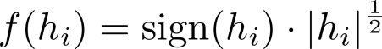
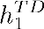
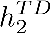
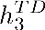
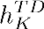
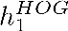
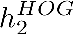
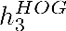
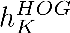
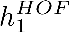
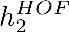
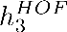

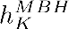
Trajectory description
The spatio-temporal volume aligned with each trajectory is considered, and Trajectory descriptor, HOG, HOF and MBH are computed around it.
Since the histograms tend to be sparse, they are power-normalized to unsparsify the representation, while still allowing for linear classification. The function: is applied to each bin.
The final descriptor is the concatenation of the four power-normalized histograms. Gestures are eventually recognized using a linear SVM 1-vs-1 classifier.
TD descriptors
BoW
HOG descriptors
BoW
Power-normalization and concatenation
HOF descriptors
BoW
MBH descriptors
BoW
Classifier
Notes:
Once we have “aligned” trajectories we can compute static and dynamic features.
In order to obtain a fixed size descriptor, the Bag of Words approach is exploited: we train four separate codebooks, one for each descriptor and each codebook contains 500 visual word.
Since we observed that our histogram tend to be sparse, we apply power-normalization following this equation.
Our final descriptor is the concatenation of the computed histograms. Gesture is computed by a linear SVM.

Slide 7
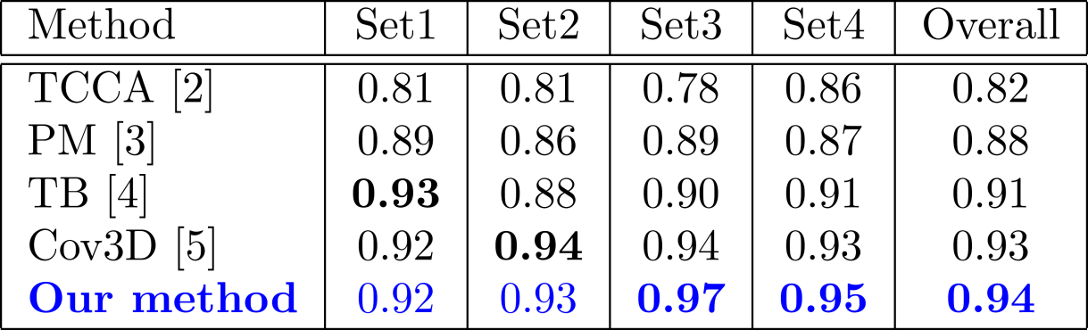
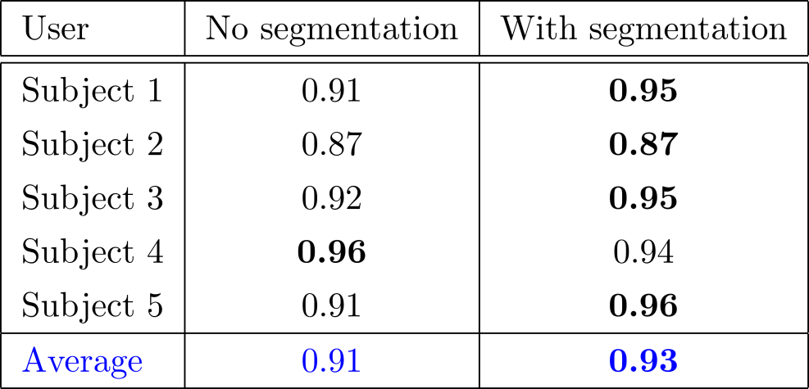
EXPERIMENTAL EVALUATION
Cambridge Gesture DB
Interactive Museum Dataset
using only two samples per class for training
[2] T.-K. Kim and R. Cipolla. Canonical correlation analysis of video volume tensors for action categorization and detection. Trans. PAMI, 2009 [3] Y. M. Lui, J. R. Beveridge, and M. Kirby. Action classification on product manifolds. In Proc. of CVPR, 2010 [4] Y. M. Lui and J. R. Beveridge. Tangent bundle for human action recognition. In In proc. of Automatic Face & Gesture Recognition and Workshops, 2011 [5] A. Sanin, C. Sanderson, M. T. Harandi, and B. C. Lovell. Spatio-temporal covariance descriptors for action and gesture recognition. In Proc. of Workshop on Applications of Computer Vision, 2013.

Slide 8
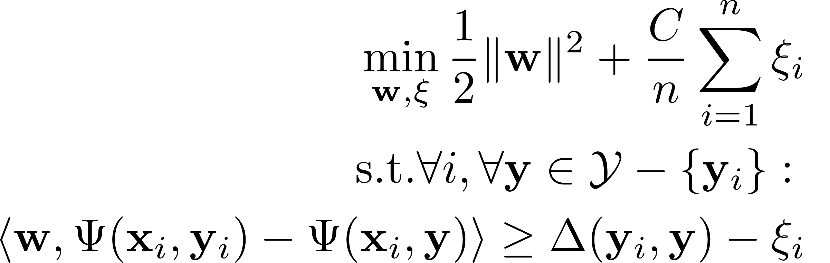
A SEQUENTIAL VERSION

Slide 9
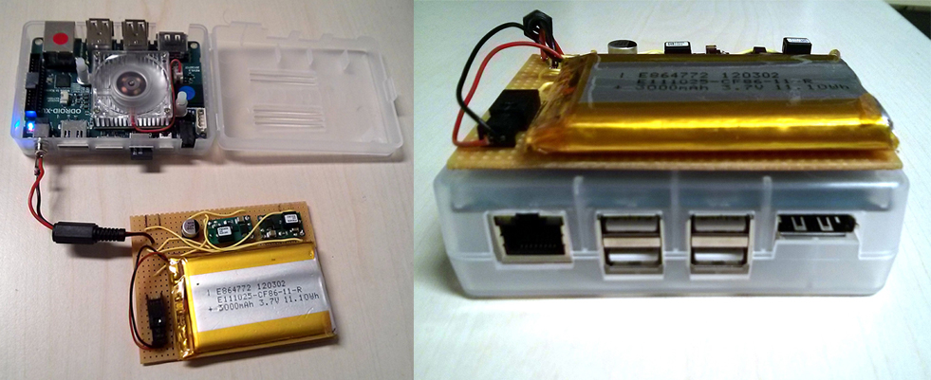
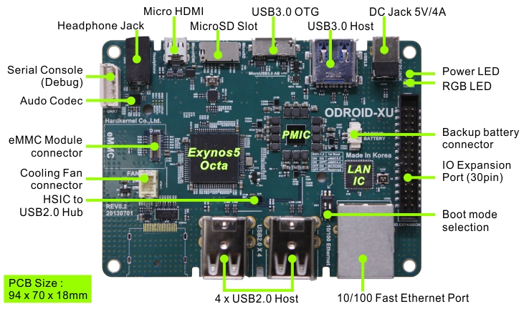
IMPLEMENTATION
The proposed algorithms have been implemented on the Odroid XU developer board:
Big.LITTLE architecture hosting Cortex-A15 and Cortex-A7 CPUs
Custom designed battery pack
A naive OpenCV implementation would run at ~2 fps
We added several low-level optimizations (compiler optimizations and Neon Intrinsics) and multi-threading with OpenMP
Runs at ~10 fps

Slide 10
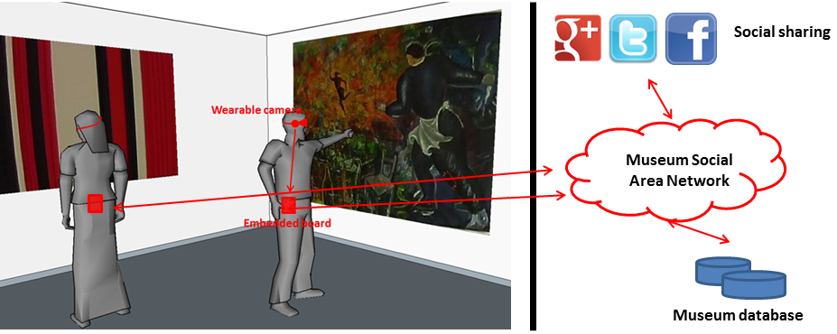
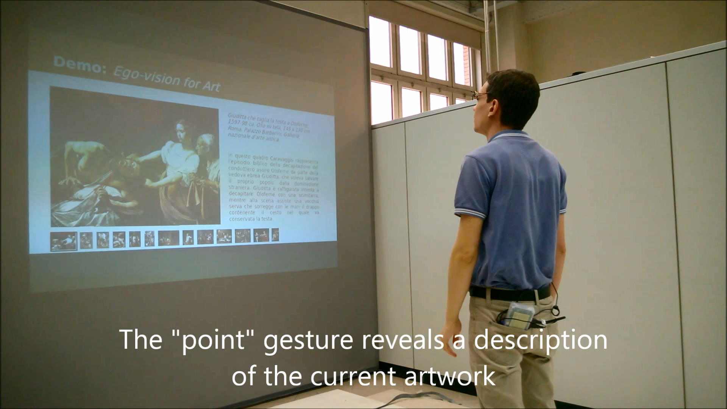
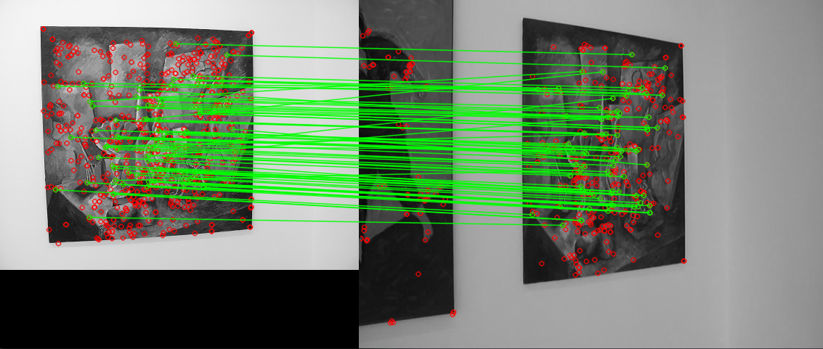
Applications
Personal devices for cultural heritage
Ask information about monuments and artworks
Artwork recognition
GPS for localization
Headphones
New HCIs based on gestures
Gesture recognition is enterely performed on the board
Connected wirelessly with a projector (MPI + WiFi)

Slide 11
PUBLICATIONS
Currently under review:
Gesture Recognition using Wearable Vision Sensors to Enhance Visitors’ Museum Experiences L. Baraldi, F. Paci, G. Serra, L. Benini, R. Cucchiara accepted with mandatory modifications to IEEE Sensors Journal
Interacting with Art: Ego-vision for Enriched Cultural Experience L. Baraldi, S. Alletto, G. Serra, R. Cucchiara submitted to Machine Vision and Applications
Conference papers:
Gesture Recognition in Ego-Centric Videos using Dense Trajectories and Hand Segmentation L. Baraldi, F. Paci, G. Serra, L. Benini, R. Cucchiara IEEE Computer Vision and Pattern Recognition (CVPR) Embedded Vision Workshop (EVW), 2014
Hand Segmentation and Gesture Recognition in EGO-Vision G. Serra, M. Camurri, L. Baraldi, M. Benedetti, R. Cucchiara in Proc. of ACM Multimedia International Workshop on Interactive Multimedia on Mobile and Portable Devices (IMMPD), 2013

Slide 12
THANKS!

